Slide 1

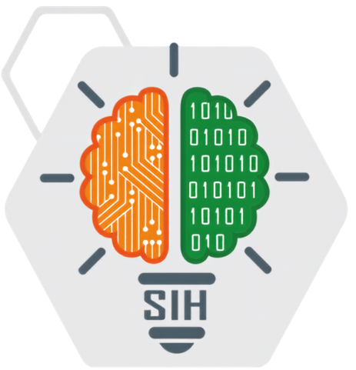





`
SMART INDIA HACKATHON 2026
SMART INDIA HACKATHON 2026
OVERSIGHT
SIH
Operational Vision & Evidence-based Real-time Smart Inspection & Governance Tracking
Problem Statement ID
Theme
26095
Smart Automation
Category
Team Name
Software
Nava Prakalp Innovators
Team ID: SRGI-18

Slide 2

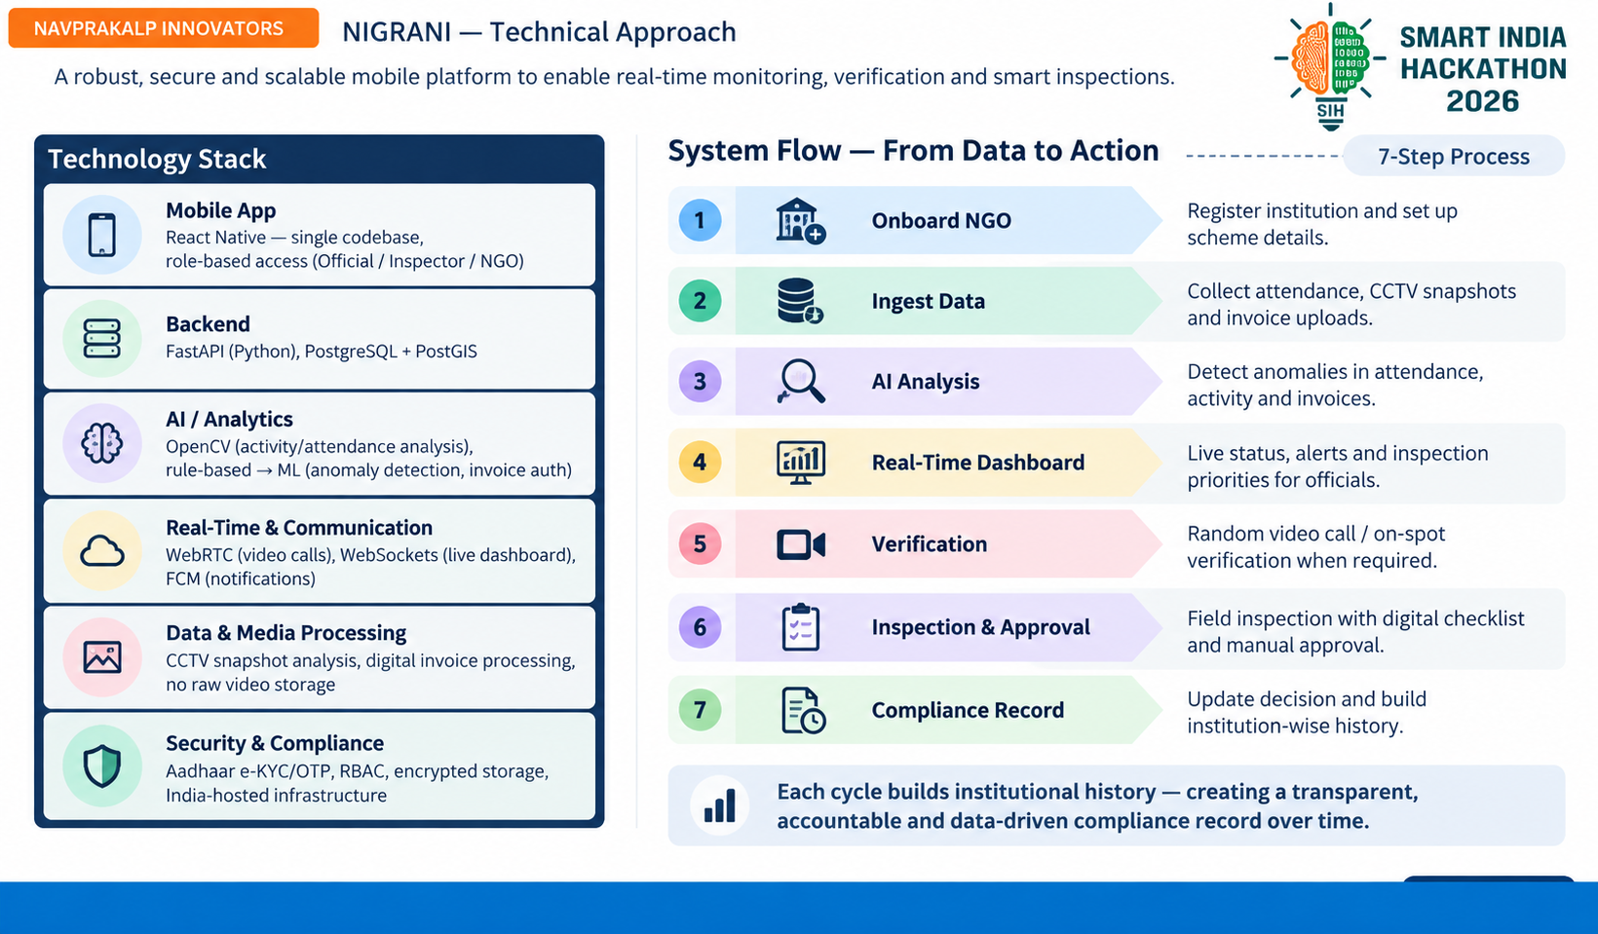





















`
NAVPRAKALP INNOVATORS
OVERSIGHT- Operational Vision & Evidence-based Real-time Smart Inspection & Governance Tracking
A single mobile application with role-based access (DoSIE Official / PMU Inspector / NGO-Institute) that continuously monitors scheme-funded institutions and helps officials decide where, when, and why a physical inspection is needed — instead of replacing inspectors, it assist them in finding out which institute is needed to be inspected.
Key Features
Innovation & Uniqueness
1. Real-Time Monitoring Dashboard
Live data & alerts for continuous monitoring of institutions.
More Transparency
Real-time, data-driven monitoring reduces fake reporting.
2. Geo-Location Authentication
Verify attendance and activity through geo-tagging.
AI as an Assistant
3. Fund Management & Invoice Verification
Digital invoice upload with AI-based authentication.
AI flags anomalies and verifies data — final approval remains with officials.
4. AI-Based Anomaly & Attendance Analysis
Faster & Smarter Inspections
Detect irregularities and unsual patterns automatically.
Helps officials plan inspections better and focus on high-risk institutions.
5. Surprise Video Call Inspection
Random video calls with staff/beneficiaries for on-spot verification.

Slide 3



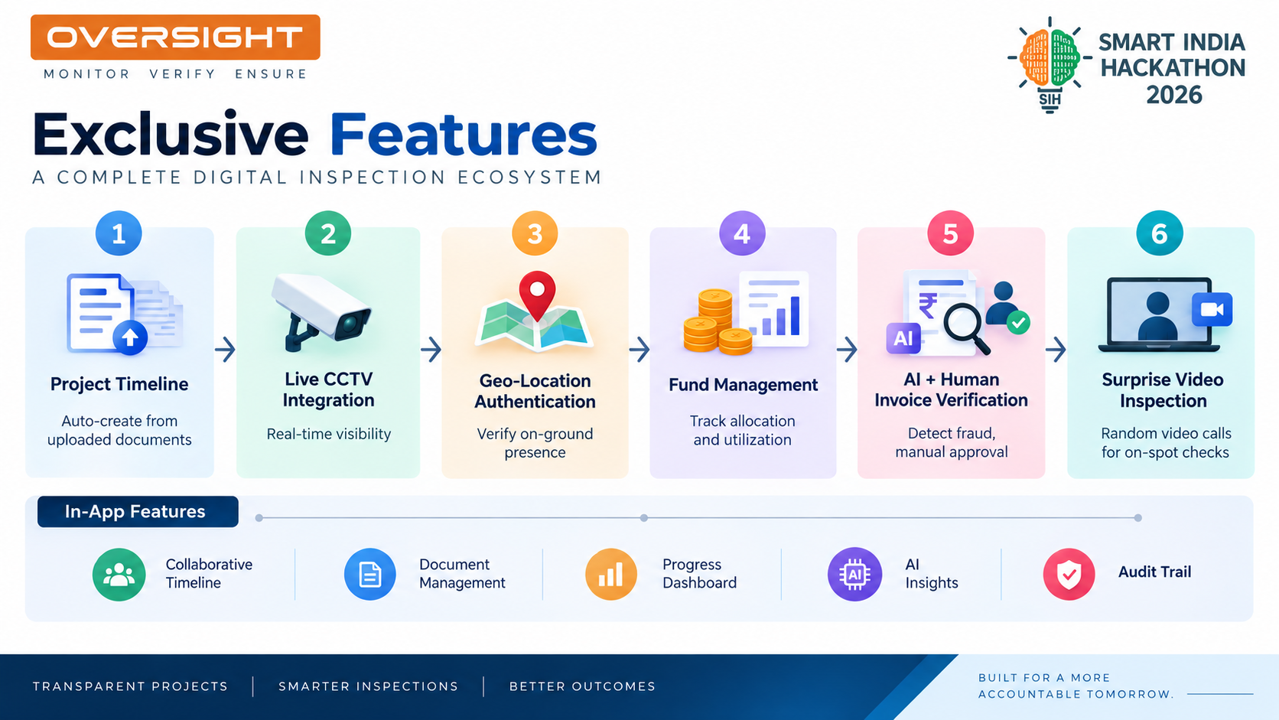
NAVPRAKALP INNOVATORS
IMPACT AND BENEFITS

Slide 4
NAVPRAKALP INNOVATORS
A robust, secure and scalable mobile platform to enable real-time monitoring, verification and smart inspections.

Slide 5






NAVPRAKALP INNOVATORS
Research & References
Technical References
Government Systems & Frameworks
Real-Time Monitoring & Dashboard
Architecture for live status, alerts, and institution monitoring.
NGO Darpan — NITI Aayog
PFMS — Ministry of Finance
Geo-Location & Identity Verification
Institution registration & directory baseline; OVERSIGHT adds real-time monitoring.
Tracks scheme fund flow; OVERSIGHT adds invoice and ground-level verification.
Geo-tagging with OTP/ e-KYC workflows for attendance and activity verification.
AI Anomaly & Attendance Analysis
Rule-based anomaly detection with scope for ML-based pattern analysis as data grows.
DARPAN Dashboard — NIC
Ministry of Social Justice & Empowerment
Reference for digital scheme-monitoring workflows and dashboards.
Scheme guidelines and NGO grant compliance requirements.
Invoice Verification & Surprise Video Inspection
Digital invoice authentication plus WebRTc-based random video verification.
OVERSIGHT combines existing government workflows with AI-assisted verification and real-time inspection support.

Slide 6
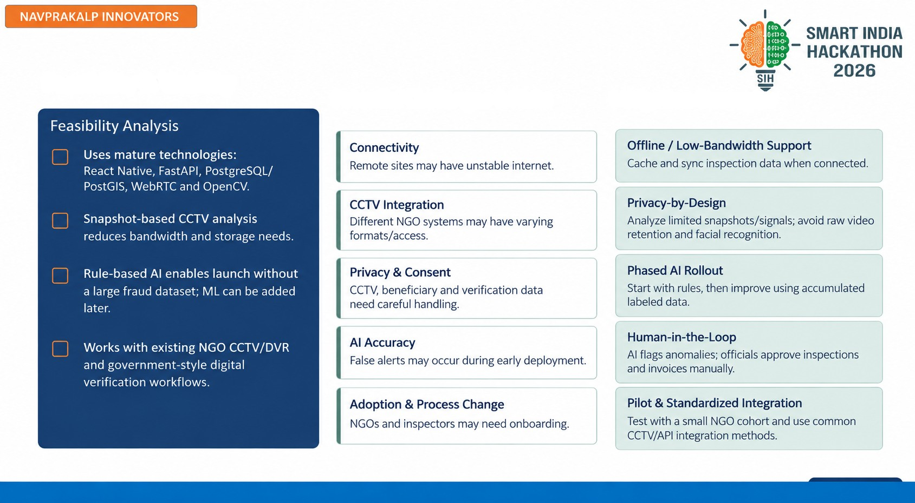
NAVPRAKALP INNOVATORS
Feasibility & Viability
Potential Challenges & Risks
Mitigation Strategies

